Slide 1
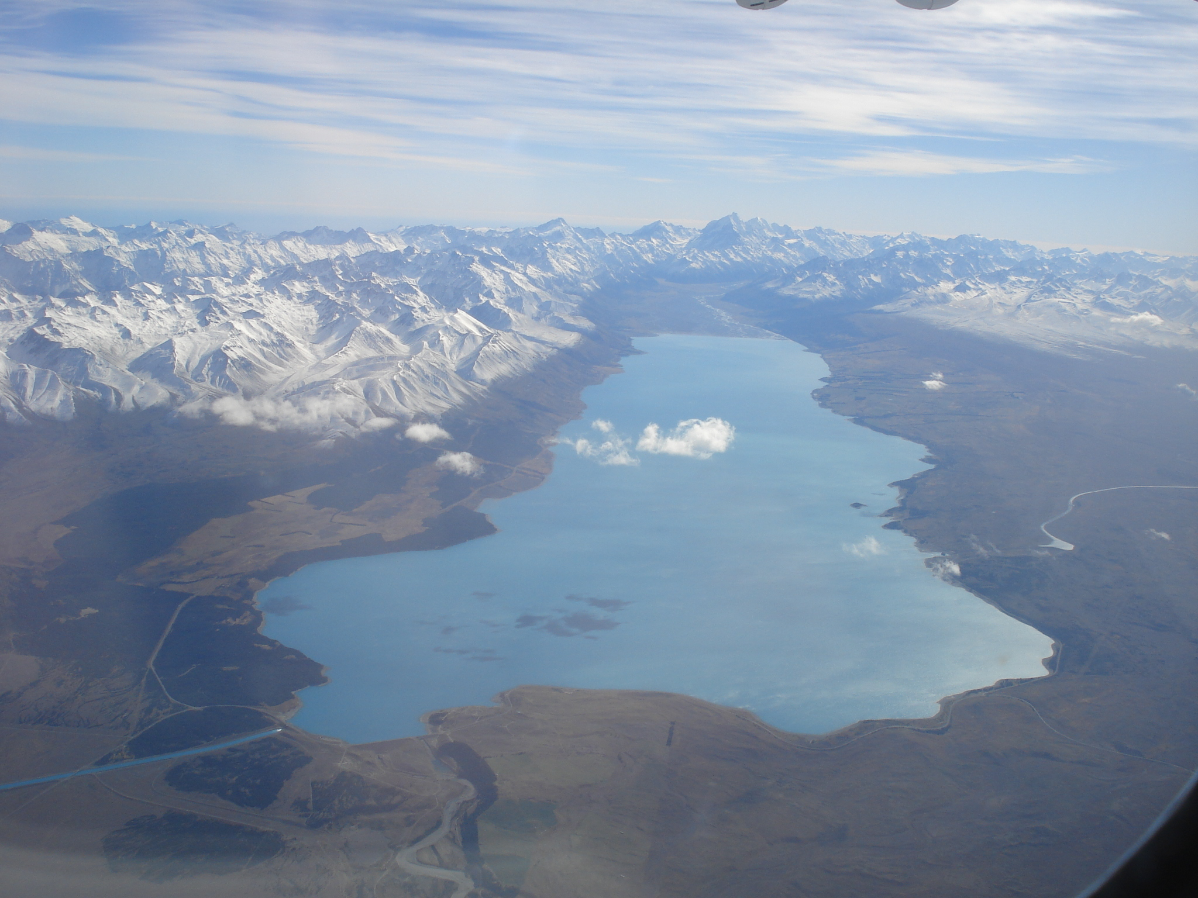
Photo Album
Wicked Wanderers’
Starting Out in Mapping
Aoraki/Mount Cook
Lake Pukaki
by jo.dudley
By Baxter, Najia, William, Jongyoon, Ursula and Sean

Slide 2
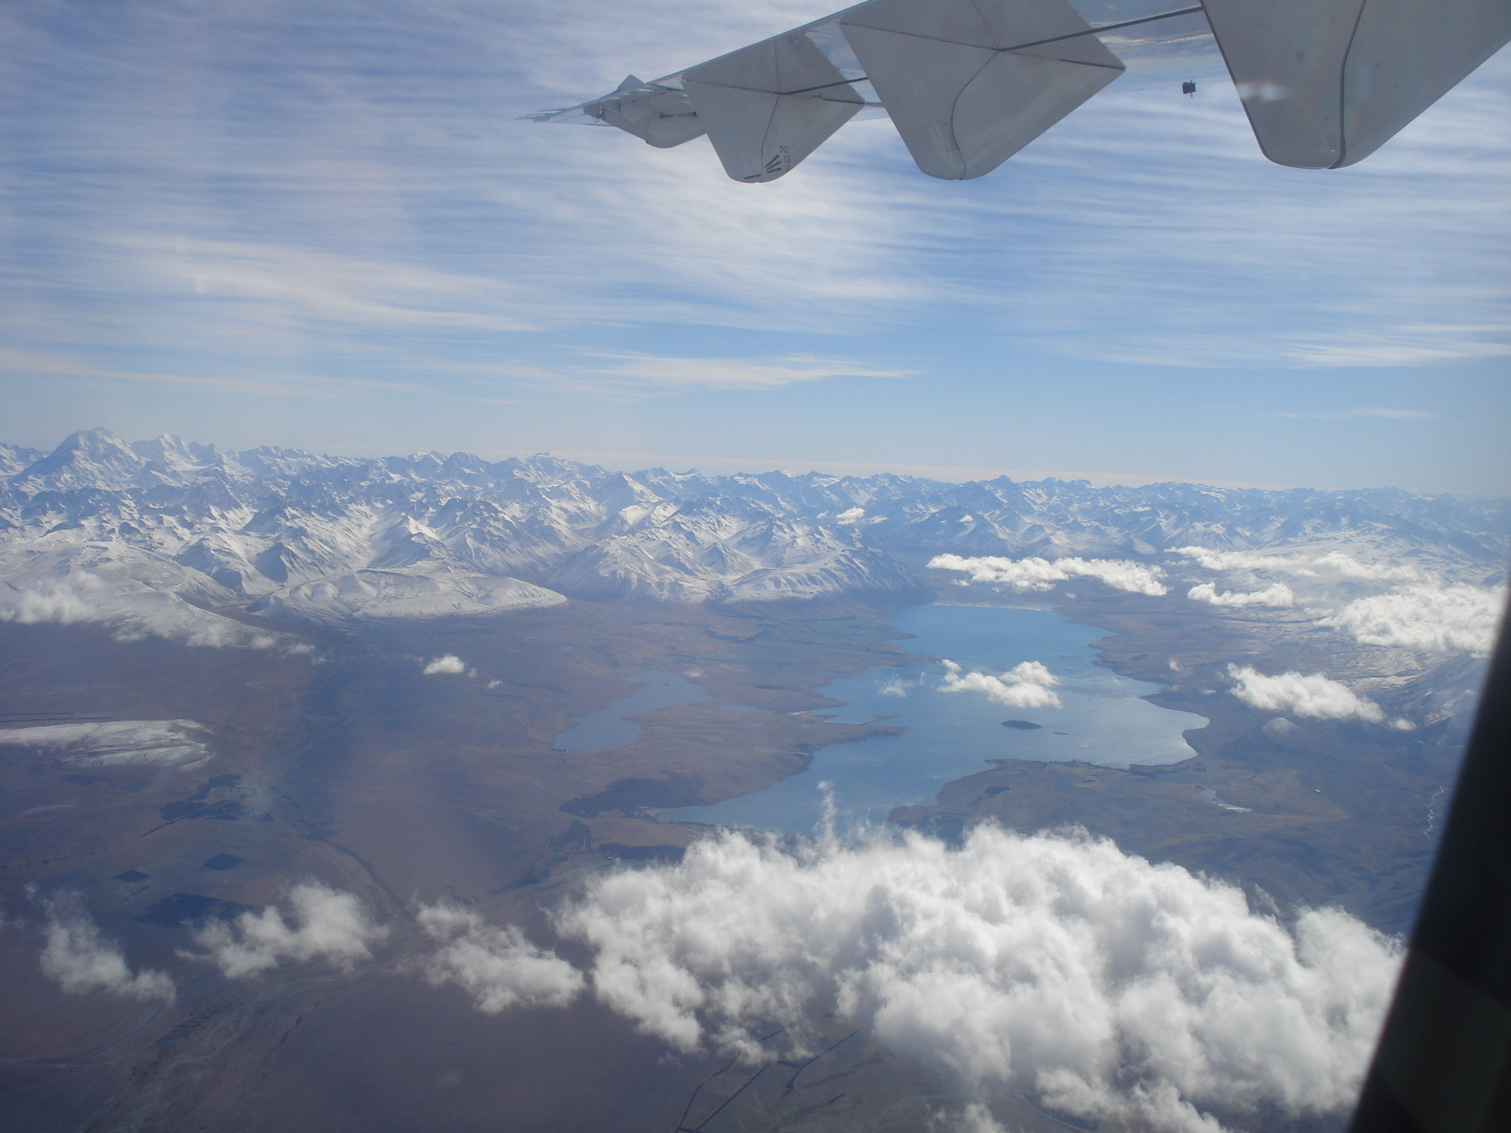
Lake Alexandrina
Lake Tekapo

Slide 3
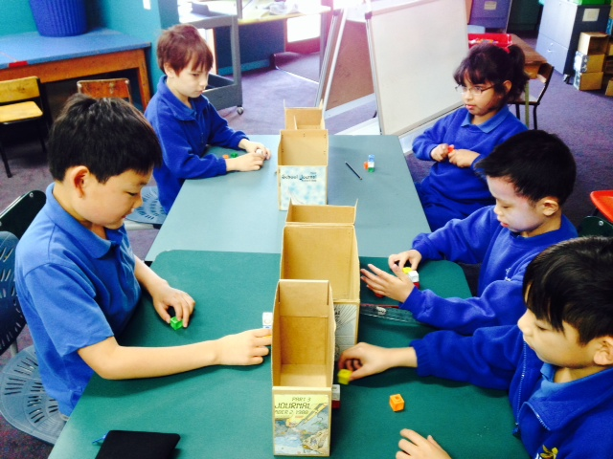

Slide 4
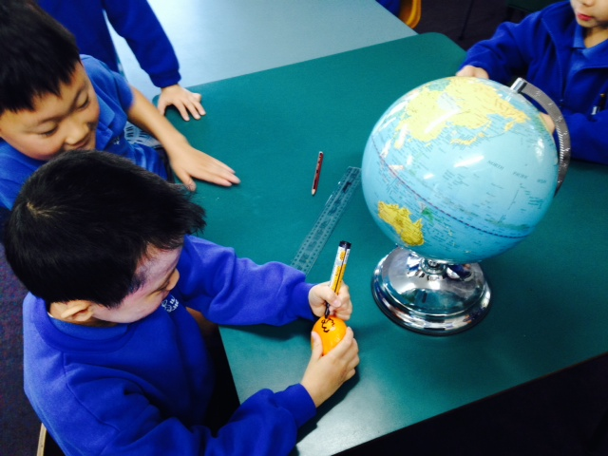

Slide 5
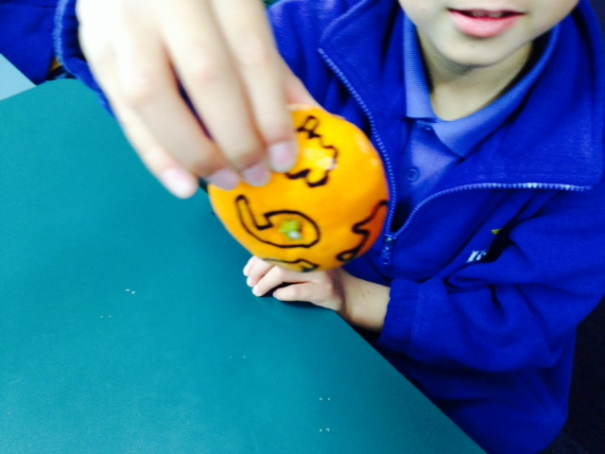

Slide 6
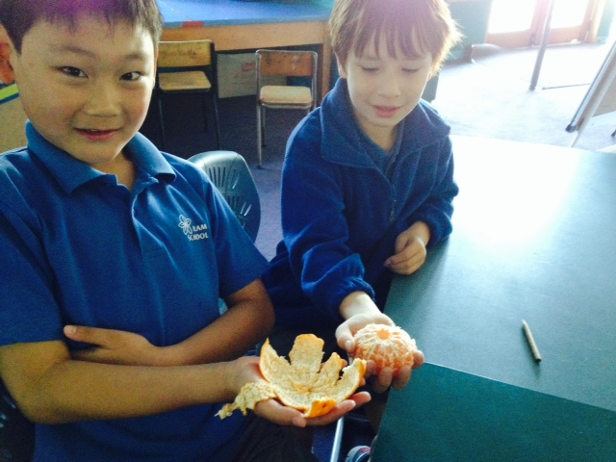

Slide 7
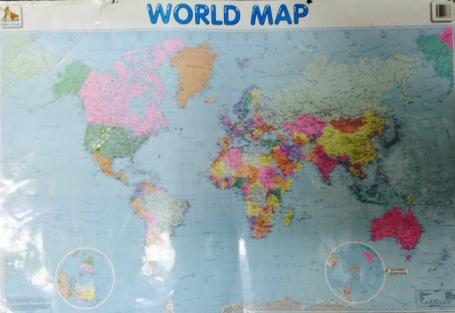
Here is the world map flattened out like our mandarin. Can you see how the North and South poles are so stretched out compared to what they look like on a globe?

Slide 8
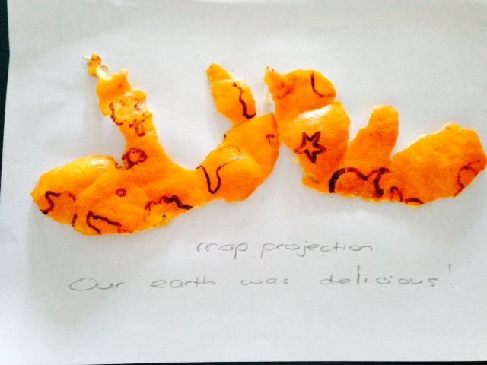
Notes:
As we lay the mandarin skin out flat we noticed the countries were stretched further apart compared to when it was a round mandarin.

Slide 9
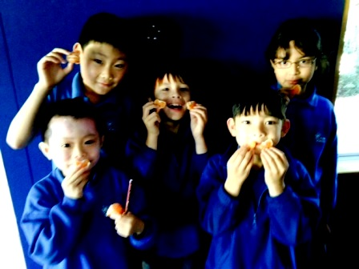
We ate our world. It was DELICIOUS.

